Slide 1

W4111 – 02: Introduction to Databases
Lecture 6: Relational Model, (Some) SQL Design Patterns, (Some) Advanced SQL
Donald F. Ferguson dff9@Columbia.edu
TRANSCENDING DISCIPLINES, TRANSFORMING LIVES

Slide 2

Contents
2 | W4111_02_S20: Introduction to Databases – Lecture 6

Slide 3
Contents
Schedule: Next few weeks.
Relational Algebra
Almost never arises in practice.
Useful for understanding SQL and other query models.
Essential for understanding query processing and optimization (Module II)
Entity-Relationship Modeling Patterns and Realization
Specialization (again) and putting some pieces together.
Ternary relationships.
Complex Attributes.
Aggregation.
Some Advanced SQL
JOIN types.
Recursive queries (not kidding).
Security.
3 | W4111_02_S20: Introduction to Databases -- Lecture 6

Slide 4
Schedule
4 | W4111_02_S20: Introduction to Databases – Lecture 6

Slide 5
Schedule
21 Feb – 23 Feb:
HW1 C due 23-Feb at 11:59 PM.
Instructor OH:
21 Feb (Friday):
1:00 to 4:00 PM (487 CSB)
4:00 to 7:00 PM (room TBA)
Tentative – 22 Feb (Saturday): 9:00 to 1:00 PM, room TBA
Tentative – 23 Feb (Sunday): 5:00 PM to 8:00 PM, room TBA
Homework 2:
Released 22-Feb
Due 07-Mar
(Take Home) Midterm:
Released 06-Mar
Due 13-Mar (NO LATE DAYS ALLOWED)
Checking on status of HW1B grading.
Indicate interest in extra OH on Piazza.
5 | W4111_02_S20: Introduction to Databases -- Lecture 6

Slide 6
Relational Model
6 | W4111_02_S20: Introduction to Databases – Lecture 6

Slide 7
Motivation
Relational Model
7 | W4111_02_S20: Introduction to Databases – Lecture 6

Slide 8
Why Relational Model (Theory)
RDBs and SQL implement and extend a formal model.
The formal model almost never arises in practice; SQL is the relational model for all practical purposes.
Why study the relational model?
Critical to how RDBs implement query processing and optimization.
Many elements of SQL (and query languages in general) become clearer when you understand the underlying algebra.
Advanced courses and TAing for DB courses require knowledge.
It is important for some more advanced classes and may arise on job/internship interviews.
8 | W4111_02_S20: Introduction to Databases -- Lecture 6

Slide 9
Relational Algebra
A procedural language consisting of a set of operations that take one or two relations as input and produce a new relation as their result.
Six basic operators
select: σ
project: ∏
union: ∪
set difference: –
Cartesian product: x
rename: ρ
Wait. What? Where did JOIN go? (Hold that thought). Hint –
The notation for select with a "where clause" is 𝜎_{𝑝}(𝑅), where 𝑝 is a predicate/condition.
The symbol for JOIN is ⋈. If 𝜃 is the ON condition, then the definition of JOIN is 𝑅⋈_{𝜃}𝐿≡𝜎_{𝜃}(𝑅×𝑆)

Slide 10
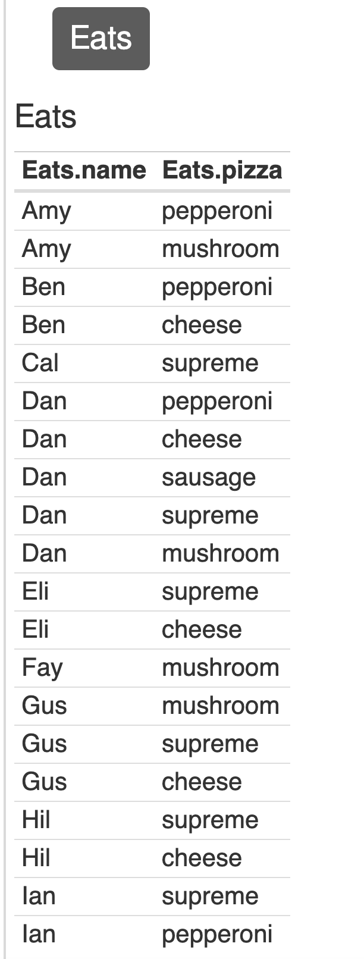
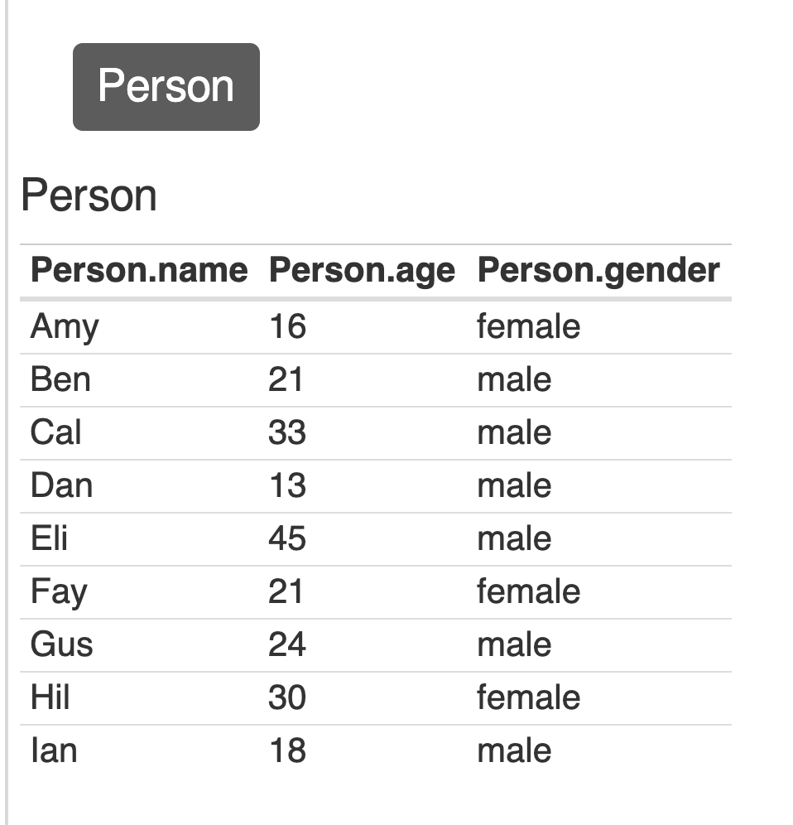
Why Relational Model (Theory) – Example
Online relational algebra calculator: https://dbis-uibk.github.io/relax/calc.htm#
Data: https://gist.github.com/woolfg/7d1871f79a8bcb4788de
10 | W4111_02_S20: Introduction to Databases -- Lecture 6

Slide 11
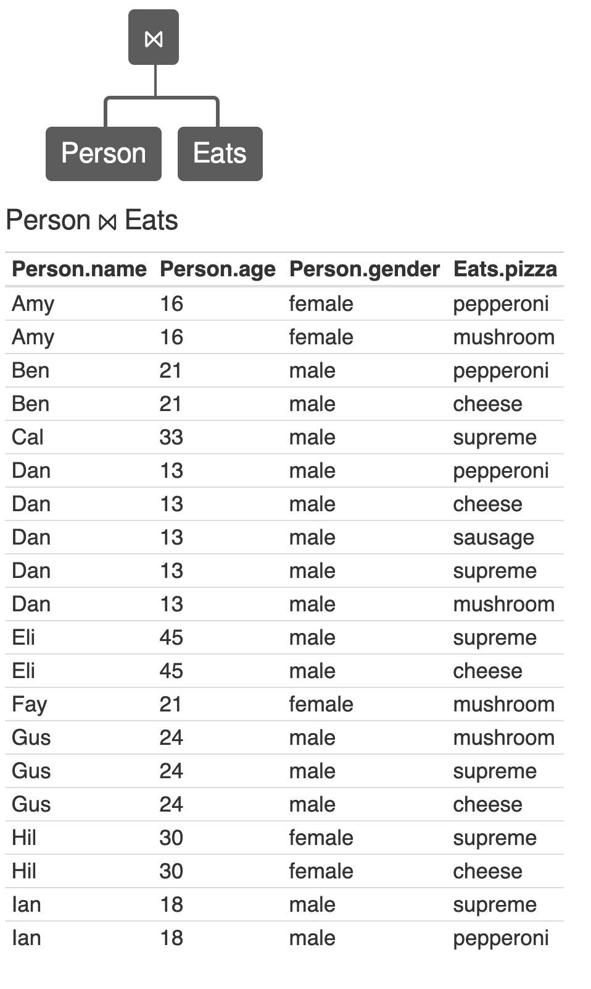
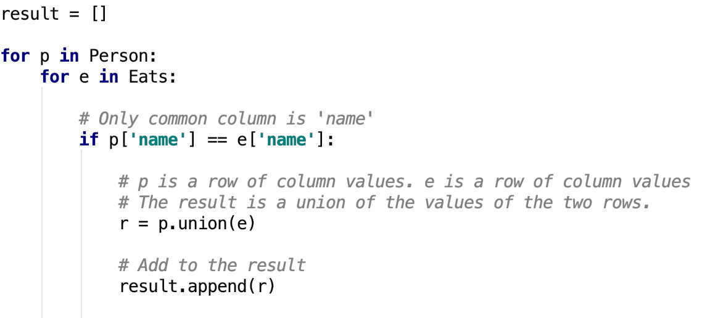
Why Relational Model (Theory) – Example
Person ⨝ Eats
The computational complexity is len(Person) * len(Eats)
11 | W4111_02_S20: Introduction to Databases -- Lecture 6

Slide 12
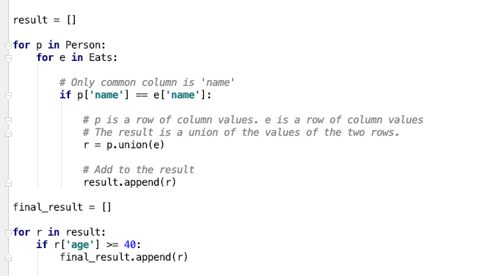
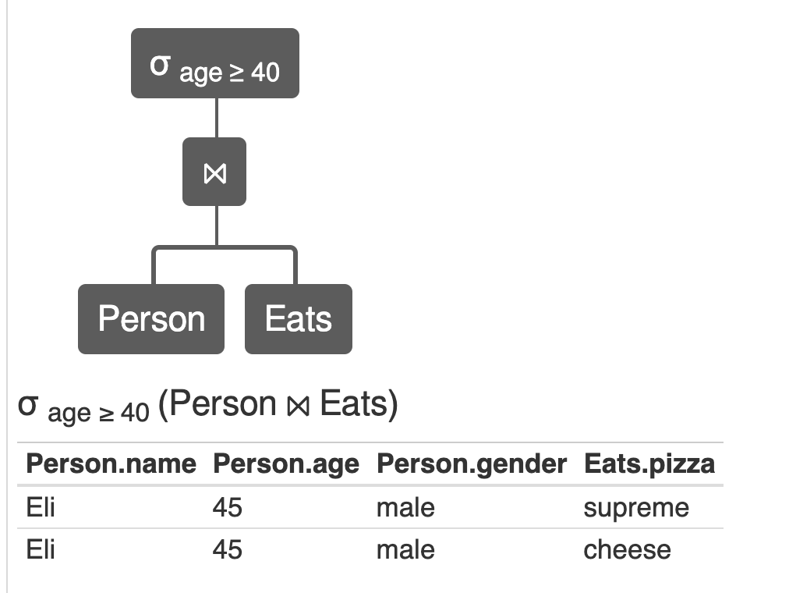
Why Relational Model (Theory) – Example
σ age>= 40 (Person ⨝ Eats)
The computational complexity is len(Person) * len(Eats) = 9 * 20 = 180
12 | W4111_02_S20: Introduction to Databases -- Lecture 6

Slide 13
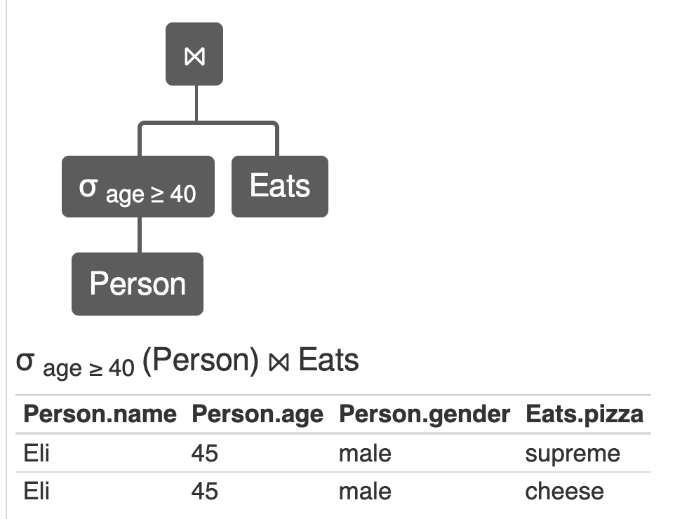
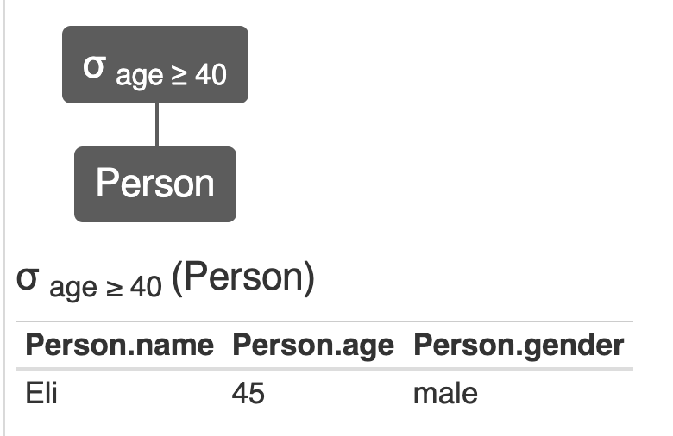
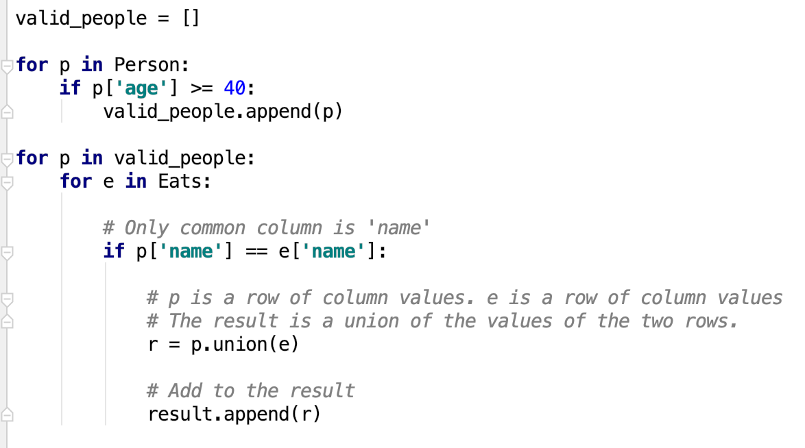
Why Relational Model (Theory) – Example
The rule of the algebra tell us
σ age>= 40(Person ⨝ Eats)
Is equivalent to
σ age>= 40 (Person) ⨝ Eats
The complexity is len(Person) + [len(σ age>= 40 (Person)) * len(Eats)] = 20 + [1 * 20] = 40.
The computational complexity is len(Person) * len(Eats) + len(…)
13 | W4111_02_S20: Introduction to Databases -- Lecture 6

Slide 14
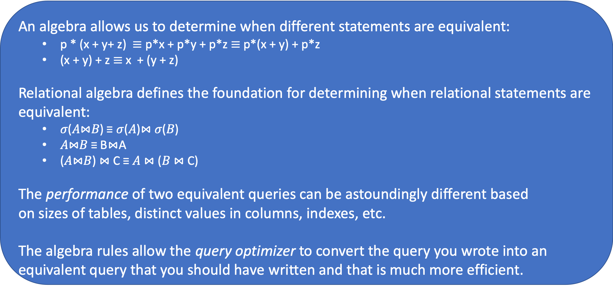
Why Relational Model (Theory) – Example
An algebra allows us to determine when different statements are equivalent:
p * (x + y+ z) $≡$ p*x + p*y + p*z $≡$ p*(x + y) + p*z
(x + y) + z $≡$ x + (y + z)
Relational algebra defines the foundation for determining when relational statements are equivalent:
𝜎(𝐴⋈𝐵) ≡ 𝜎(𝐴)⋈ 𝜎(𝐵)
𝐴⋈𝐵 ≡ B⋈A
(𝐴⋈𝐵) ⋈ C ≡ 𝐴 ⋈ (𝐵 ⋈ C)
The performance of two equivalent queries can be astoundingly different based on sizes of tables, distinct values in columns, indexes, etc.
The algebra rules allow the query optimizer to convert the query you wrote into an equivalent query that you should have written and that is much more efficient.
The rule of the algebra tell us
σ age>= 40(Person ⨝ Eats)
Is equivalent to
σ age>= 40 (Person) ⨝ Eats
The complexity is len(Person) + [len(σ age>= 40 (Person)) * len(Eats)] = 20 + [1 * 20] = 40.
The computational complexity is len(Person) * len(Eats) + len(…)
14 | W4111_02_S20: Introduction to Databases -- Lecture 6

Slide 15
Relational Algebra (from the textbook)
Relational Model
15 | W4111_02_S20: Introduction to Databases – Lecture 5

Slide 16
Relational Query Languages
Procedural versus non-procedural, or declarative
“Pure” languages:
Relational algebra
Tuple relational calculus
Domain relational calculus
The above 3 pure languages are equivalent in computing power
We will concentrate in this chapter on relational algebra
Not turning-machine equivalent
Consists of 6 basic operations

Slide 17
Relational Algebra
A procedural language consisting of a set of operations that take one or two relations as input and produce a new relation as their result.
Six basic operators
select: σ
project: ∏
union: ∪
set difference: –
Cartesian product: x
rename: ρ

Slide 18
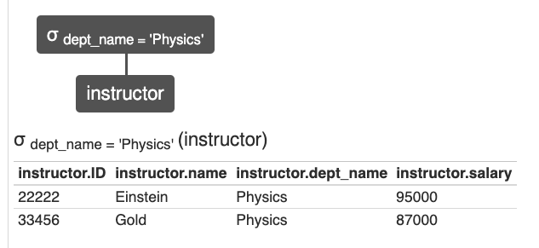
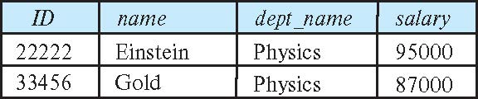
Select Operation
The select operation selects tuples that satisfy a given predicate.
Notation: σ _{p} (r)
p is called the selection predicate
Example: select those tuples of the instructor relation where the instructor is in the “Physics” department.
Query
σ _{dept_name=“Physics”} (instructor)
Result
From:
https://dbis-uibk.github.io/relax/calc.htm#

Slide 19
Select Operation (Cont.)
We allow comparisons using
=, ≠, >, ≥. <. ≤
in the selection predicate.
We can combine several predicates into a larger predicate by using the connectives:
∧ (and), ∨ (or), ¬ (not)
Example: Find the instructors in Physics with a salary greater $90,000, we write:
σ _{dept_name=“Physics”} ∧ _{salary} > 90,000 (instructor)
Then select predicate may include comparisons between two attributes.
Example, find all departments whose name is the same as their building name:
σ _{dept_name=building} (department)

Slide 20
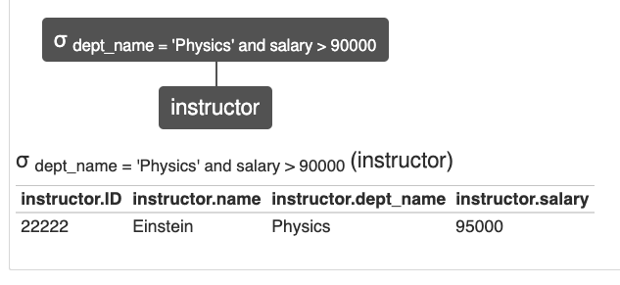
Select Operation (Cont.)
We allow comparisons using
=, ≠, >, ≥. <. ≤
in the selection predicate.
We can combine several predicates into a larger predicate by using the connectives:
∧ (and), ∨ (or), ¬ (not)
Example: Find the instructors in Physics with a salary greater $90,000, we write:
σ _{dept_name=“Physics”} ∧ _{salary} > 90,000 (instructor)
Then select predicate may include comparisons between two attributes.
Example, find all departments whose name is the same as their building name:
σ _{dept_name=building} (department)

Slide 21
Project Operation
A unary operation that returns its argument relation, with certain attributes left out.
Notation:
∏ _{A1,A2,A3 ….Ak} (r)
where A₁, A₂ are attribute names and r is a relation name.
The result is defined as the relation of k columns obtained by erasing the columns that are not listed
Duplicate rows removed from result, since relations are sets (<dff>SQL does not behave this way</dff>)

Slide 22
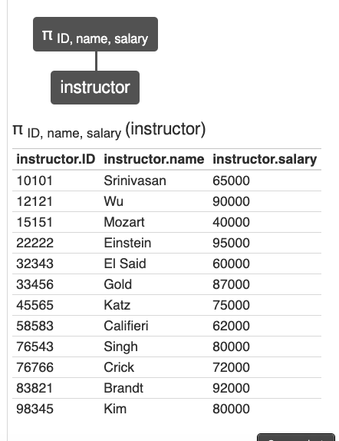
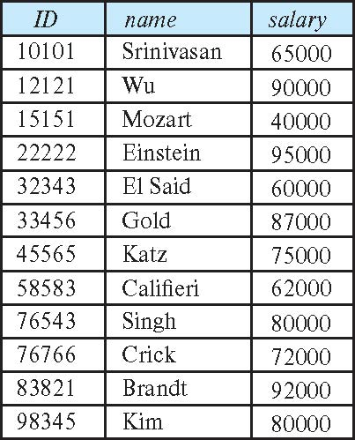
Project Operation (Cont.)
Example: eliminate the dept_name attribute of instructor
Query: ∏_{ID, name, salary} (instructor)
Result:

Slide 23
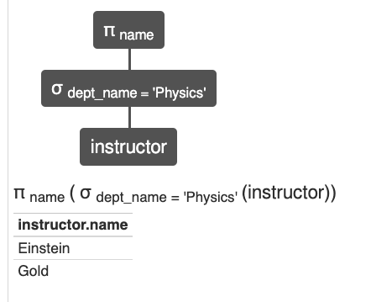
Composition of Relational Operations
The result of a relational-algebra operation is relation and therefore of relational-algebra operations can be composed together into a relational-algebra expression.
Consider the query -- Find the names of all instructors in the Physics department.
∏_{name}(σ _{dept_name} _{=“Physics”} (instructor))
Instead of giving the name of a relation as the argument of the projection operation, we give an expression that evaluates to a relation.

Slide 24
Cartesian-Product Operation
The Cartesian-product operation (denoted by X) allows us to combine information from any two relations.
Example: the Cartesian product of the relations instructor and teaches is written as:
instructor X teaches
We construct a tuple of the result out of each possible pair of tuples: one from the instructor relation and one from the teaches relation (see next slide)
Since the instructor ID appears in both relations we distinguish between these attribute by attaching to the attribute the name of the relation from which the attribute originally came.
instructor.ID
teaches.ID

Slide 25
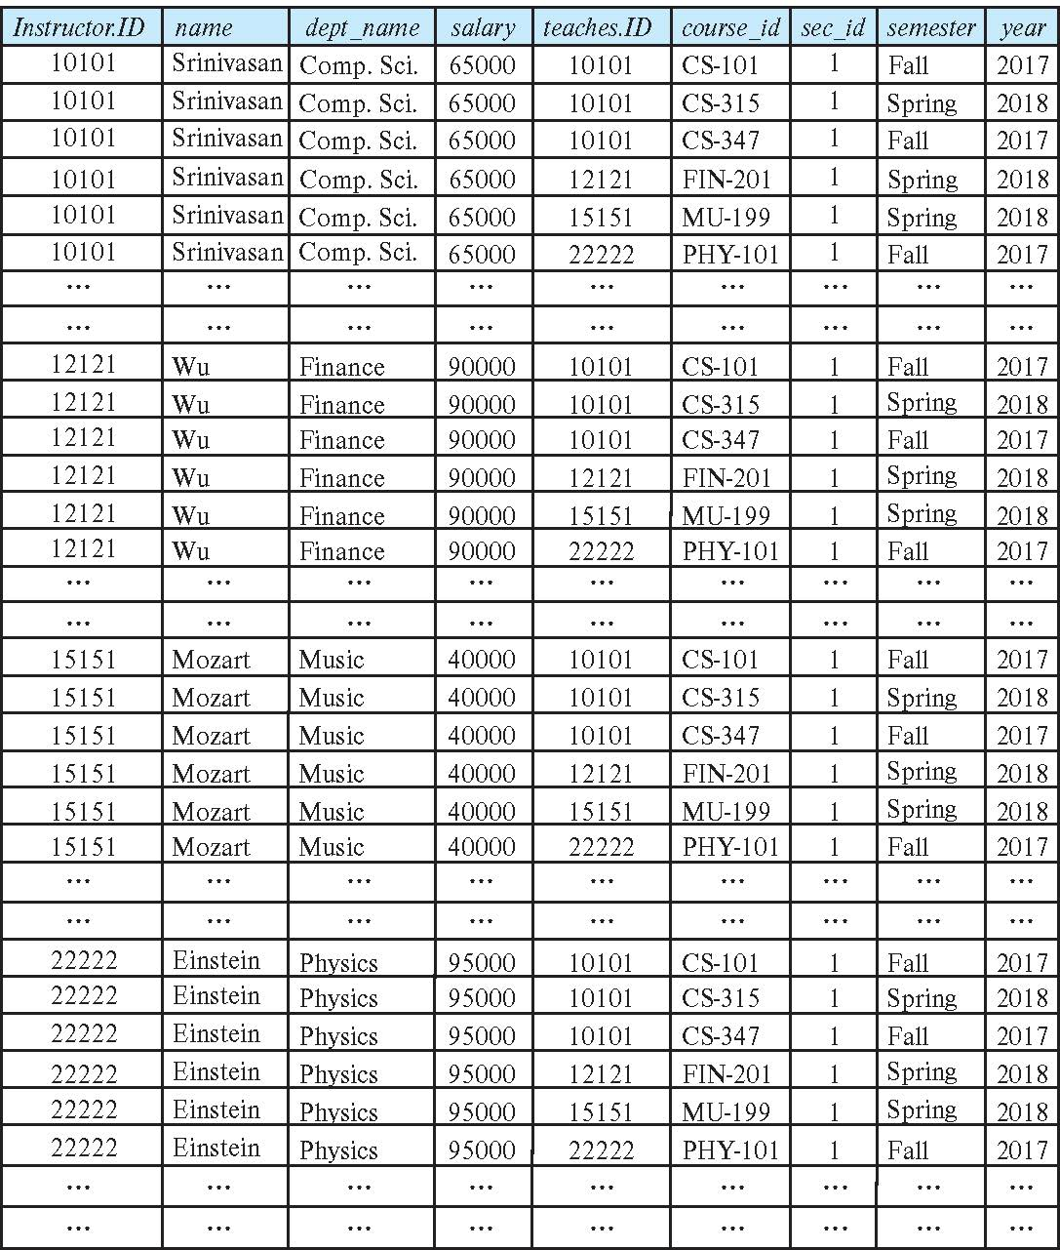
The instructor X teaches table

Slide 26
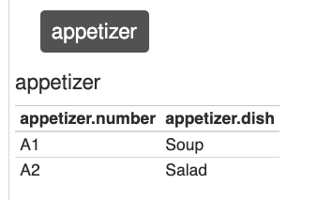
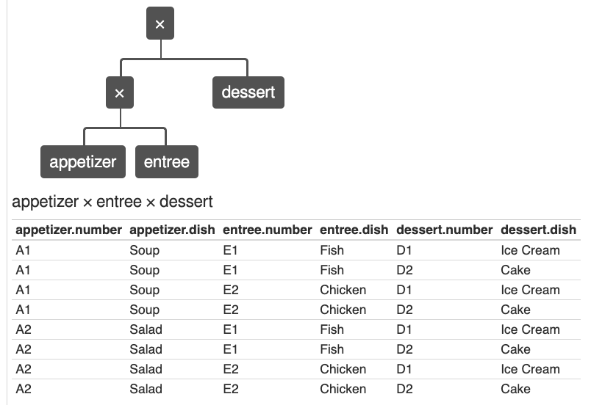
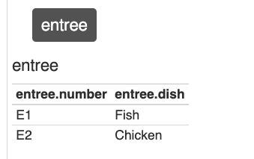
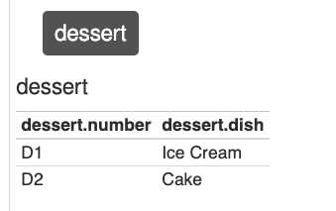
Cartesian Product Simpler Example
But sometimes you need to think
about it.
Instructor X course
Is every possible pairing, including pairing me with
Latin GU4105 section 001 LAT LITERATURE OF THE REPUBLIC
Sometimes this makes sense, …
26 | W4111_02_S20: Introduction to Databases -- Lecture 6

Slide 27
Join Operation
The Cartesian-Product
instructor X teaches
associates every tuple of instructor with every tuple of teaches.
Most of the resulting rows have information about instructors who did NOT teach a particular course.
To get only those tuples of “instructor X teaches “ that pertain to instructors and the courses that they taught, we write:
σ _{instructor.id = teaches.id} (instructor x teaches ))
We get only those tuples of “instructor X teaches” that pertain to instructors and the courses that they taught.
The result of this expression, shown in the next slide

Slide 28
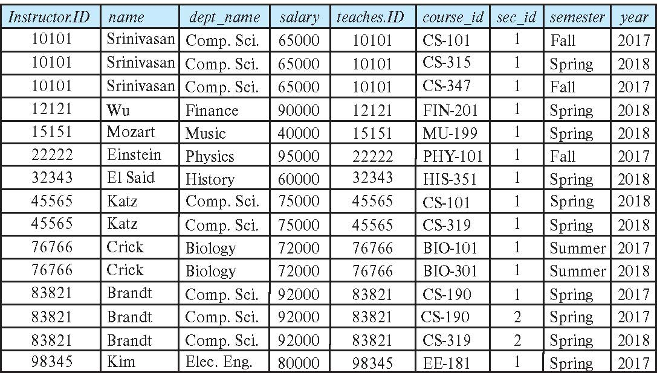
Join Operation (Cont.)
The table corresponding to:
σ _{instructor.id = teaches.id} (instructor x teaches))

Slide 29
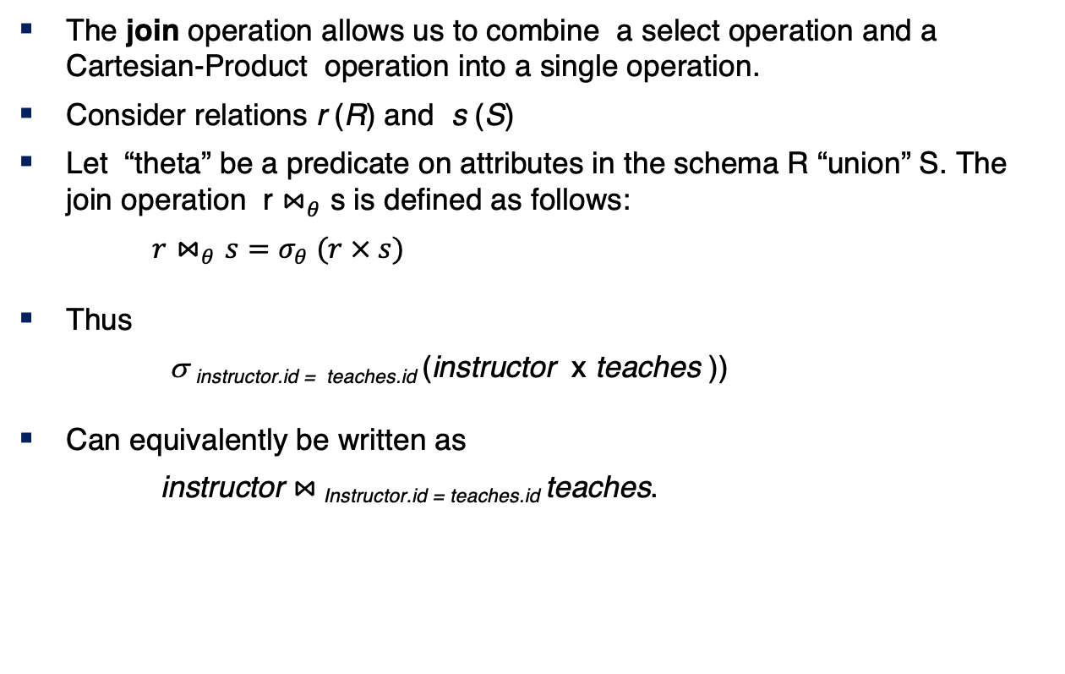
Join Operation (Cont.)
The join operation allows us to combine a select operation and a Cartesian-Product operation into a single operation.
Consider relations r (R) and s (S)
Let “theta” be a predicate on attributes in the schema R “union” S. The join operation r $⋈_{θ}$ s is defined as follows:
$r⋈_{θ}s=σ_{θ} (r × s)$
Thus
σ _{instructor.id = teaches.id} (instructor x teaches ))
Can equivalently be written as
instructor $⋈_{ }$_{Instructor.id = teaches.id} teaches.

Slide 30
Union Operation
The union operation allows us to combine two relations
Notation: r ∪ s
For r ∪ s to be valid.
1. r, s must have the same arity (same number of attributes)
2. The attribute domains must be compatible (example: 2nd
column of r deals with the same type of values as does the 2nd column of s)
Example: to find all courses taught in the Fall 2017 semester, or in the Spring 2018 semester, or in both ∏_{course_id} (σ _{semester=“Fall” Λ year=2017} (section)) ∪ ∏_{course_id} (σ _{semester=“Spring” Λ year=2018} (section))

Slide 31
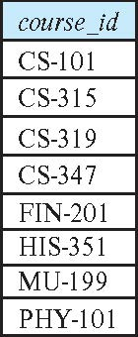
Union Operation (Cont.)
Result of: ∏_{course_id} (σ _{semester=“Fall” Λ year=2017} (section)) ∪ ∏_{course_id} (σ _{semester=“Spring” Λ year=2018} (section))

Slide 32
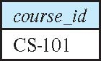
Set-Intersection Operation
The set-intersection operation allows us to find tuples that are in both the input relations.
Notation: r ∩ s
Assume:
r, s have the same arity
attributes of r and s are compatible
Example: Find the set of all courses taught in both the Fall 2017 and the Spring 2018 semesters.
∏_{course_id} (σ _{semester=“Fall” Λ year=2017} (section)) ∩ ∏_{course_id} (σ _{semester=“Spring” Λ year=2018} (section))
Result

Slide 33
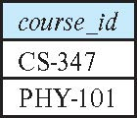
Set Difference Operation
The set-difference operation allows us to find tuples that are in one relation but are not in another.
Notation r – s
Set differences must be taken between compatible relations.
r and s must have the same arity
attribute domains of r and s must be compatible
Example: to find all courses taught in the Fall 2017 semester, but not in the Spring 2018 semester ∏_{course_id} (σ _{semester=“Fall” Λ year=2017} (section)) − ∏_{course_id} (σ _{semester=“Spring” Λ year=2018} (section))

Slide 34
The Assignment Operation
It is convenient at times to write a relational-algebra expression by assigning parts of it to temporary relation variables.
The assignment operation is denoted by ← and works like assignment in a programming language.
Example: Find all instructor in the “Physics” and Music department. Physics ← σ _{dept_name=“Physics”} (instructor)
Music ← σ _{dept_name=“Music”} (instructor)
Physics ∪ Music
With the assignment operation, a query can be written as a sequential program consisting of a series of assignments followed by an expression whose value is displayed as the result of the query.

Slide 35
The Rename Operation
The results of relational-algebra expressions do not have a name that we can use to refer to them. The rename operator, ρ , is provided for that purpose
The expression:
ρ_{x} (E)
returns the result of expression E under the name x
Another form of the rename operation:
ρ_{x(A1,A2, .. An)} (E)

Slide 36
Equivalent Queries
There is more than one way to write a query in relational algebra.
Example: Find information about courses taught by instructors in the Physics department with salary greater than 90,000
Query 1
σ _{dept_name=“Physics”} ∧ _{salary > 90,000} (instructor)
Query 2
σ _{dept_name=“Physics”} (σ _{salary > 90.000} (instructor))
The two queries are not identical; they are, however, equivalent -- they give the same result on any database.

Slide 37
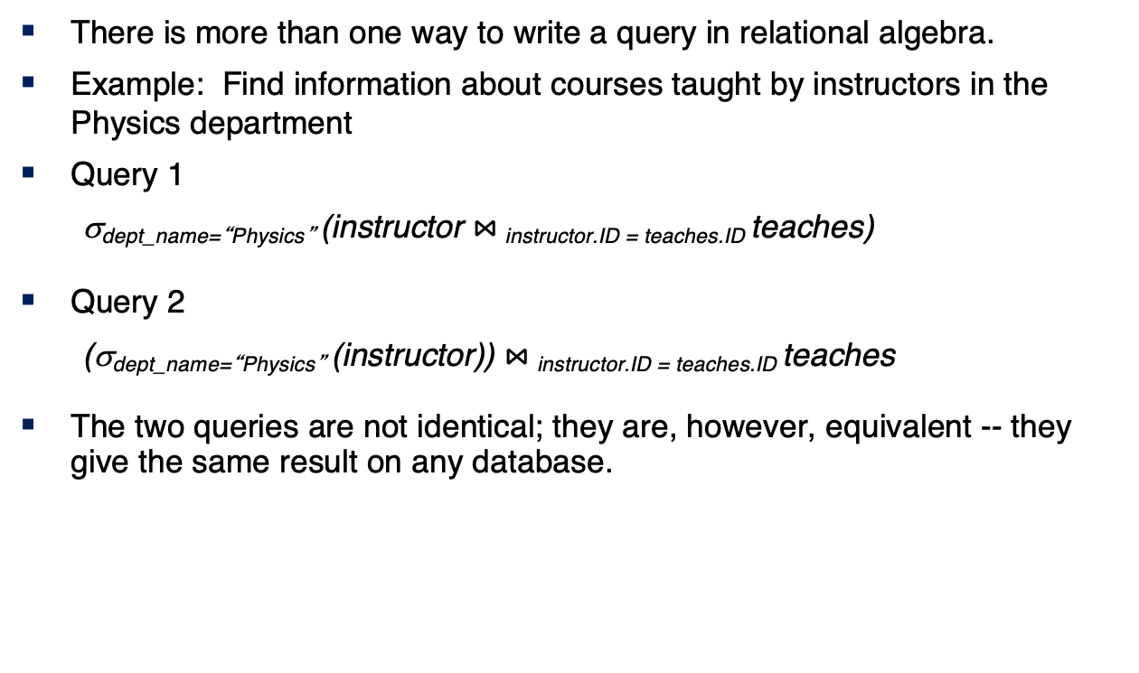
Equivalent Queries
There is more than one way to write a query in relational algebra.
Example: Find information about courses taught by instructors in the Physics department
Query 1
σ_{dept_name=“Physics”} (instructor $⋈_{ }$_{instructor.ID = teaches.ID} teaches)
Query 2
(σ_{dept_name=“Physics”} (instructor)) $⋈_{ }$_{instructor.ID = teaches.ID} teaches
The two queries are not identical; they are, however, equivalent -- they give the same result on any database.

Slide 38
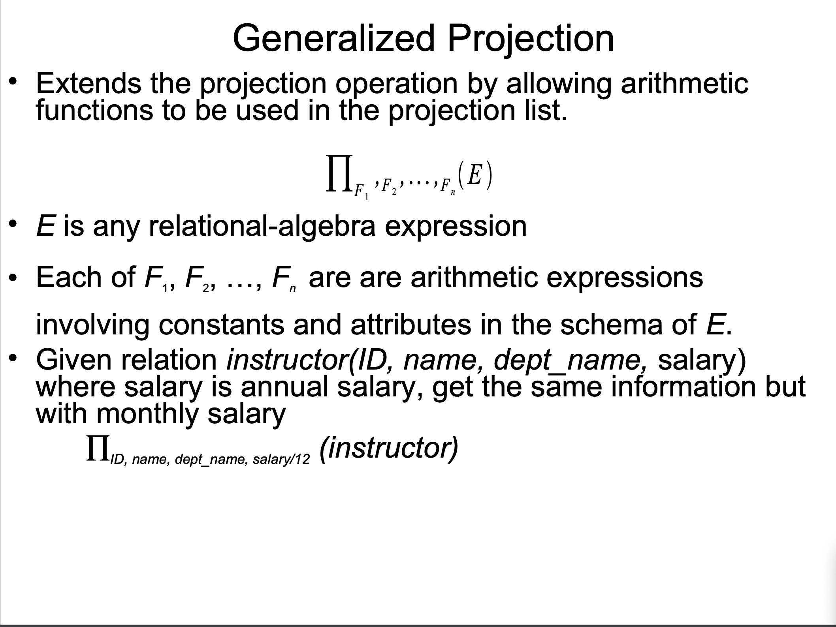
Generalization Projection
http://www.cbcb.umd.edu/confcour/Spring2014/CMSC424/Relational_algebra.pdf
38 | W4111_02_S20: Introduction to Databases -- Lecture 6

Slide 39
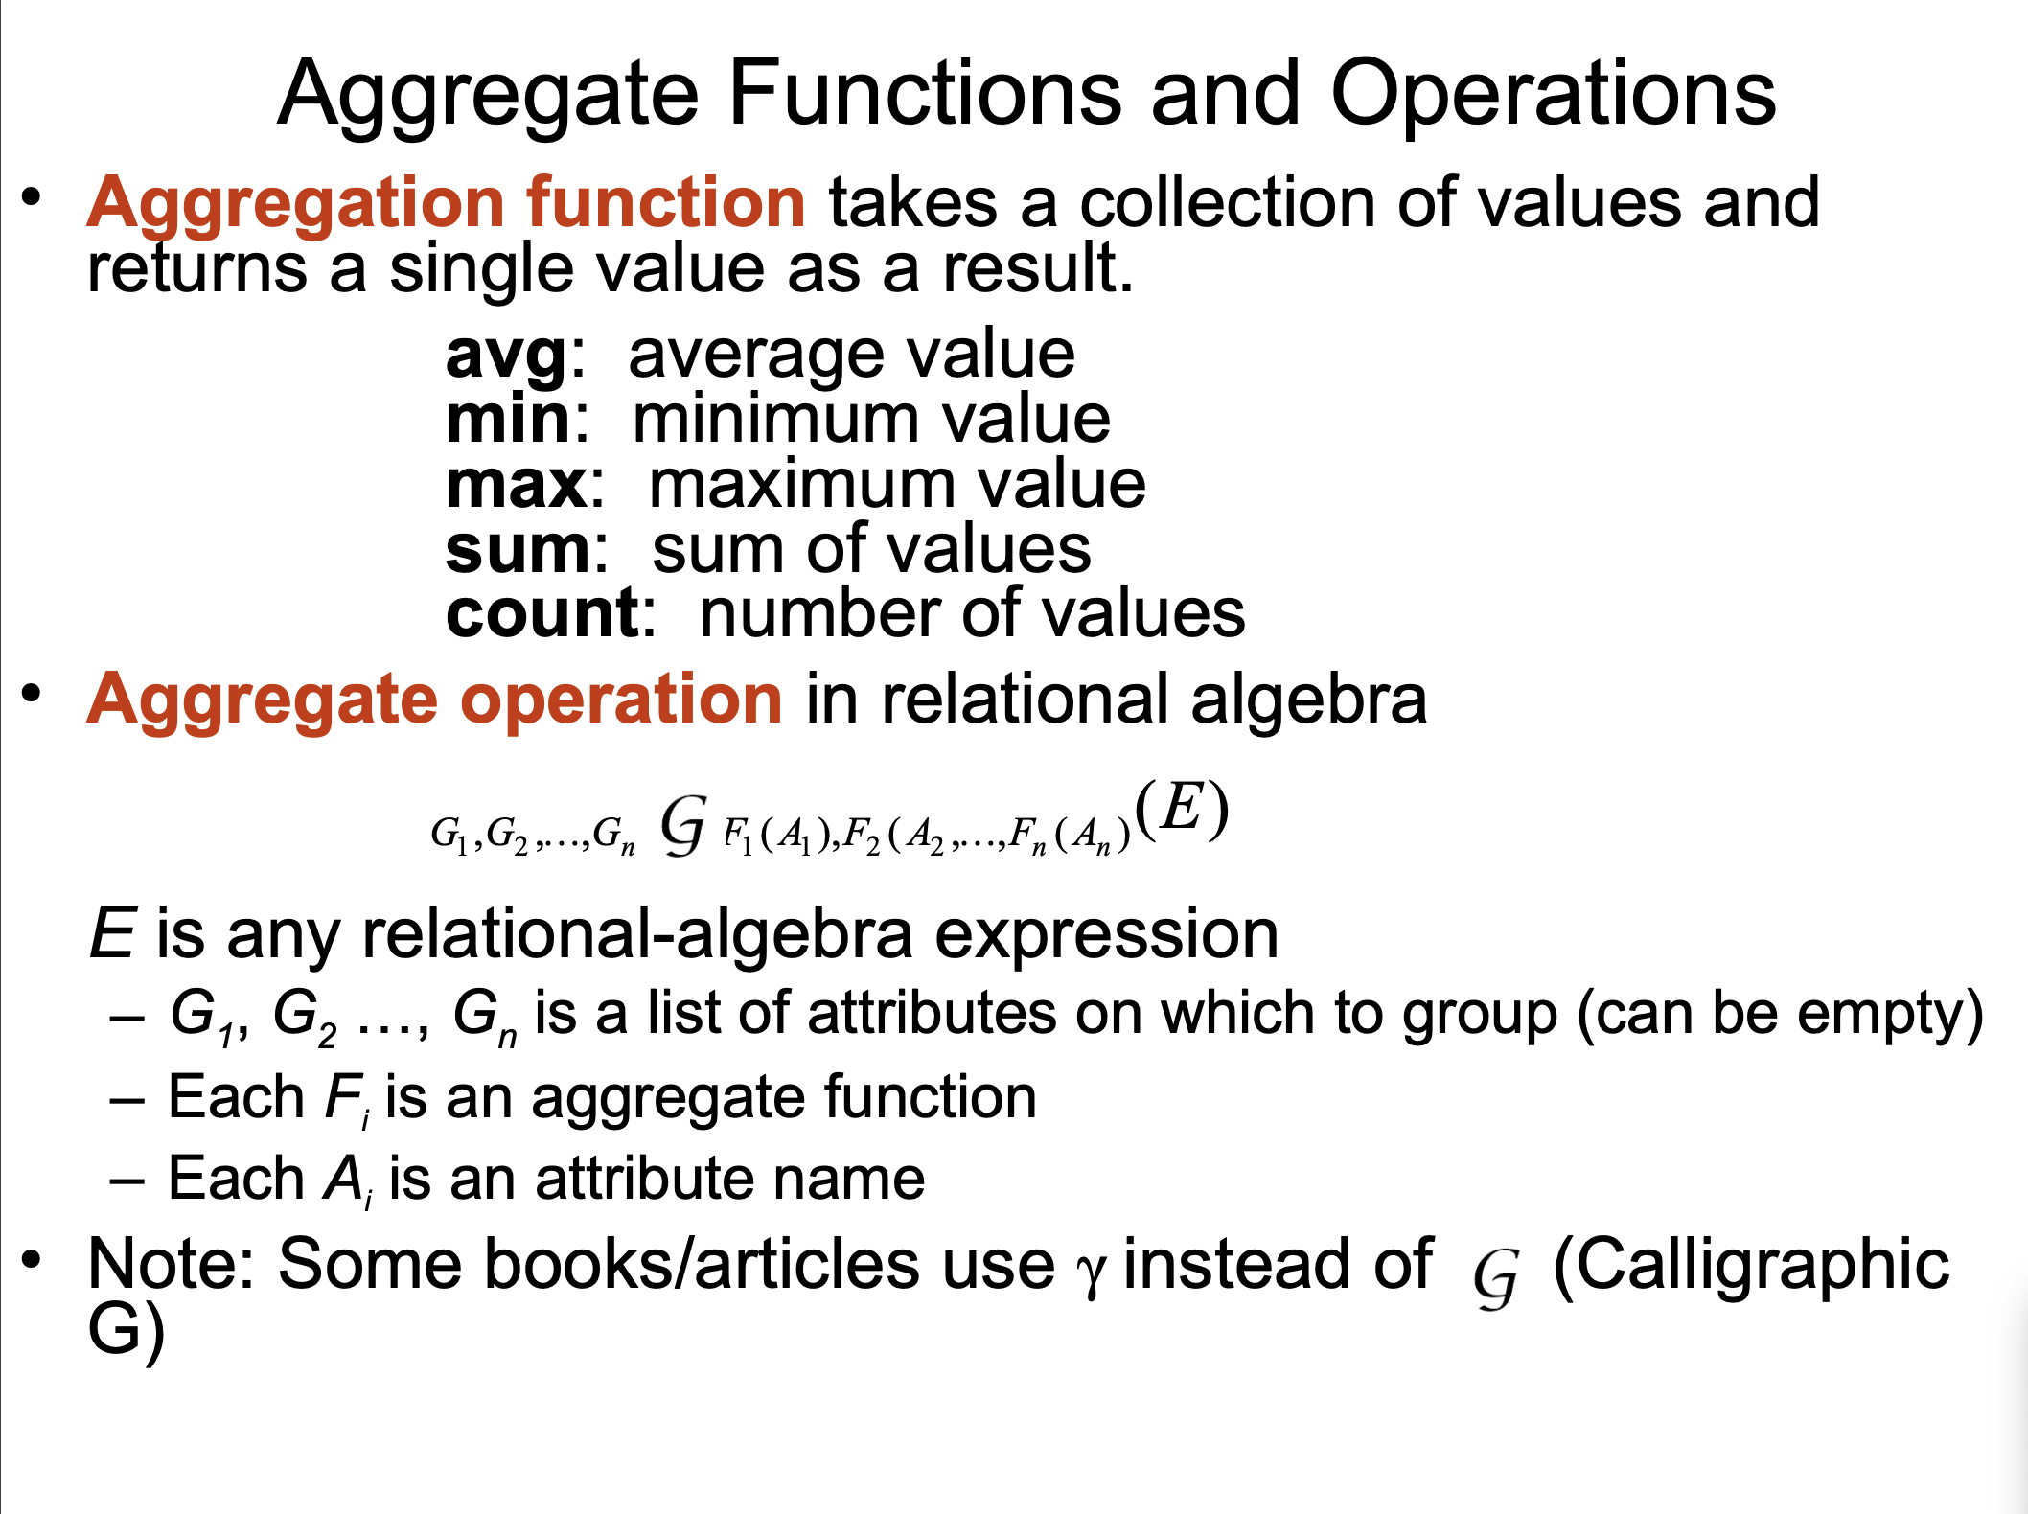
Aggregation
http://www.cbcb.umd.edu/confcour/Spring2014/CMSC424/Relational_algebra.pdf
39 | W4111_02_S20: Introduction to Databases -- Lecture 6

Slide 40
Some More Advanced ER Modeling
40 | W4111_02_S20: Introduction to Databases – Lecture 5

Slide 41
Specialization
Relational Model
41 | W4111_02_S20: Introduction to Databases – Lecture 5

Slide 42
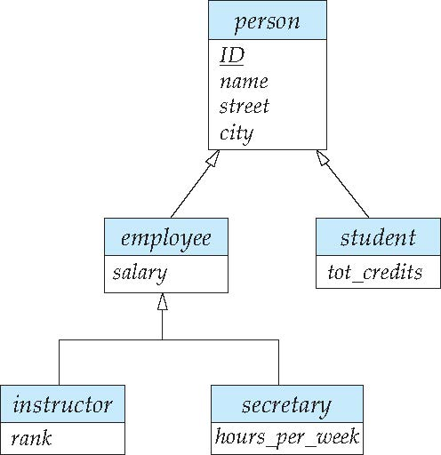
Specialization Example
Overlapping – employee and student
Disjoint – instructor and secretary
Total and partial

Slide 43
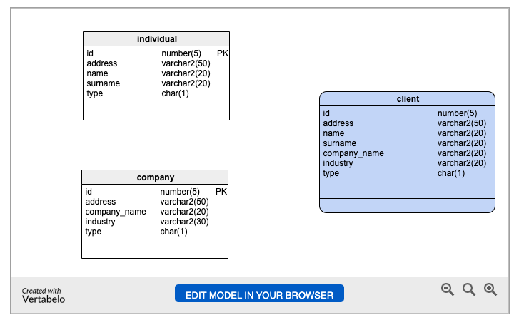
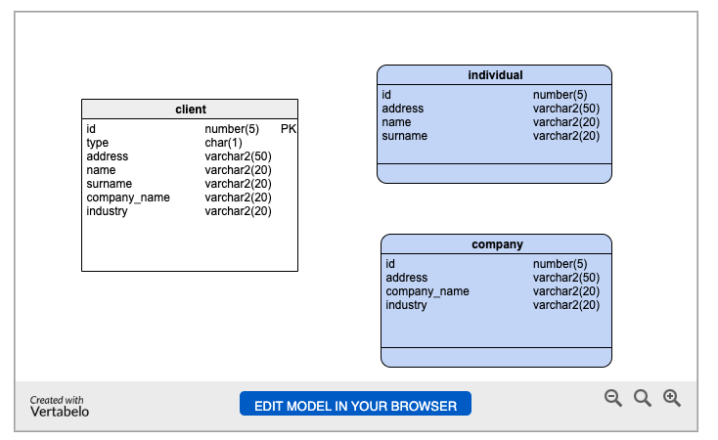
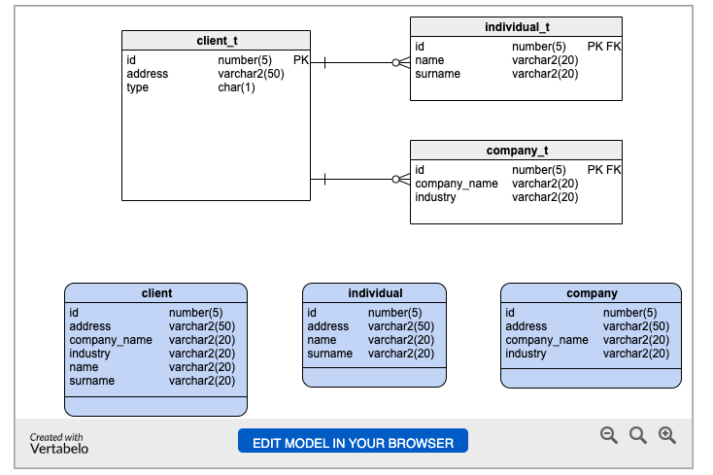
Specialization/Inheritance – Design Approaches
Two Table
One Table
Three Table
https://www.vertabelo.com/blog/inheritance-in-a-relational-database/
43 | W4111_02_S20: Introduction to Databases -- Lecture 5

Slide 44
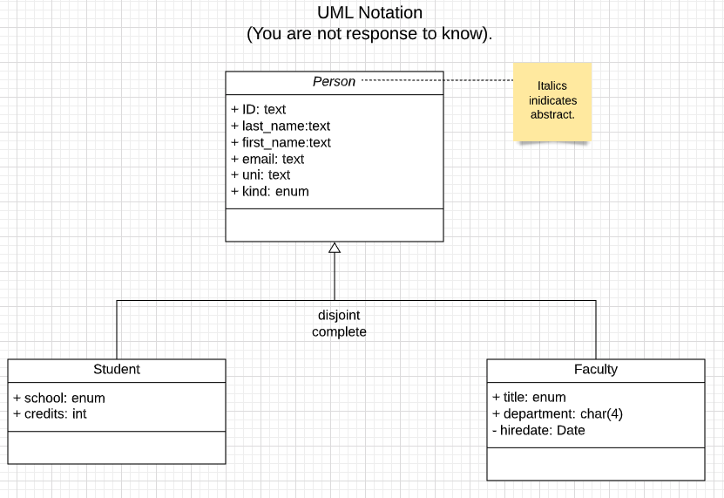
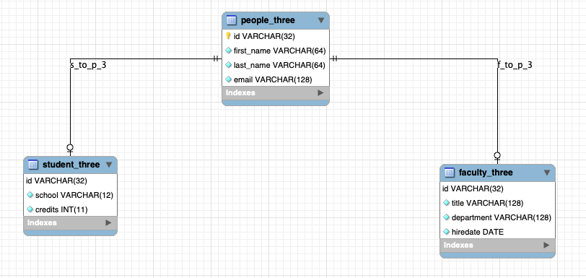
Three Table Solution to University People (Reminder)
44 | W4111_02_S20: Introduction to Databases -- Lecture 6

Slide 45
Switch to Notebook
45 | W4111_02_S20: Introduction to Databases -- Lecture 6

Slide 46
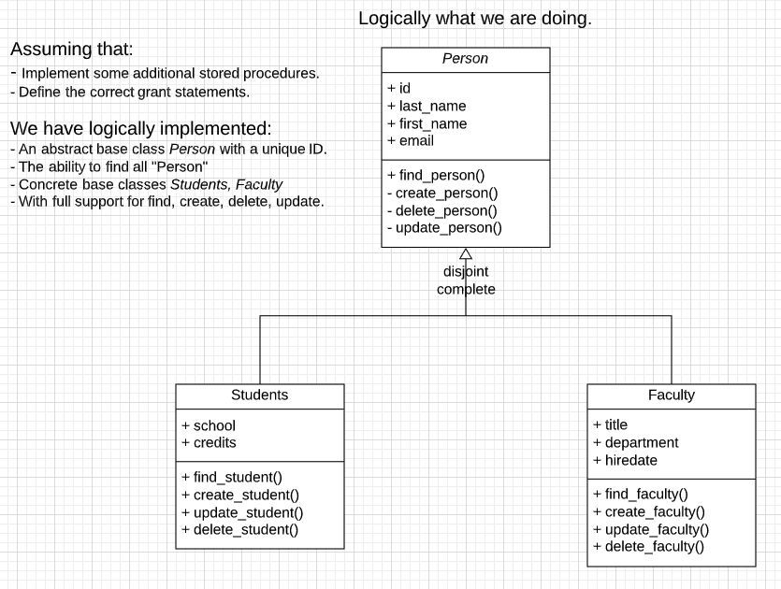
What we have Logically Done (are Doing)
Some additional constraints:
Completeness: There is no way to make a Person that is not a Student or Faculty.
Disjoint: It is still possible to have a Student and Faculty with the same ID.
We can implement disjoint with
Check constraint, except most DBMS do not support subqueries in check constraints.
Triggers.
46 | W4111_02_S20: Introduction to Databases -- Lecture 6

Slide 47
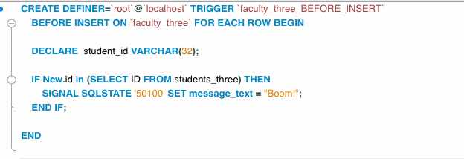
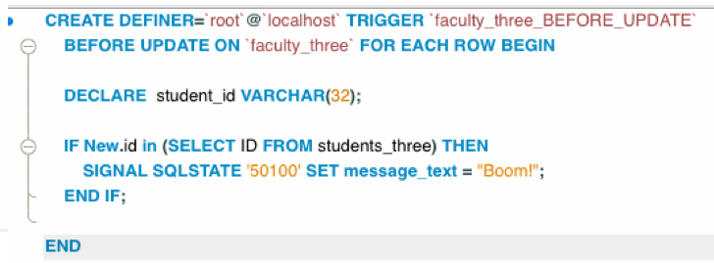
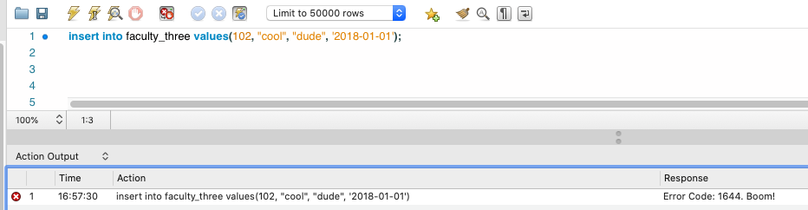
What we have Logically Done (are Doing)
47 | W4111_02_S20: Introduction to Databases -- Lecture 6

Slide 48
Roles
Relational Model
48 | W4111_02_S20: Introduction to Databases – Lecture 5

Slide 49
Roles
Entity sets of a relationship need not be distinct
Each occurrence of an entity set plays a “role” in the relationship
The labels “course_id” and “prereq_id” are called roles.
DFF Note: The concept of roles applies to all relationships/associations.

Slide 50
Relationships
Relational Model
50 | W4111_02_S20: Introduction to Databases – Lecture 5

Slide 51
Degree of a Relationship Set
Binary relationship
involve two entity sets (or degree two).
most relationship sets in a database system are binary.
Relationships between more than two entity sets are rare. Most relationships are binary. (More on this later.)
Example: students work on research projects under the guidance of an instructor.
relationship proj_guide is a ternary relationship between instructor, student, and project

Slide 52
Non-binary Relationship Sets
Most relationship sets are binary
There are occasions when it is more convenient to represent relationships as non-binary.
E-R Diagram with a Ternary Relationship
Note: In SQL/RDB, this requires four tables (relations)
Instructor
Student
Project
“Project Participants”

Slide 53
Complex Attributes
Relational Model
53 | W4111_02_S20: Introduction to Databases – Lecture 5

Slide 54
Complex Attributes
Attribute types:
Simple and composite attributes.
Single-valued and multivalued attributes
Example: multivalued attribute: phone_numbers
Derived attributes
Can be computed from other attributes
Example: age, given date_of_birth
Domain – the set of permitted values for each attribute

Slide 55
Composite Attributes
Composite attributes allow us to divided attributes into subparts (other attributes).

Slide 56
Representing Complex Attributes in ER Diagram

Slide 57
Aggregation
Relational Model
57 | W4111_02_S20: Introduction to Databases – Lecture 5

Slide 58
Aggregation
Consider the ternary relationship proj_guide, which we saw earlier
Suppose we want to record evaluations of a student by a guide on a project

Slide 59
Aggregation (Cont.)
Relationship sets eval_for and proj_guide represent overlapping information
Every eval_for relationship corresponds to a proj_guide relationship
However, some proj_guide relationships may not correspond to any eval_for relationships
So we can’t discard the proj_guide relationship
Eliminate this redundancy via aggregation
Treat relationship as an abstract entity
Allows relationships between relationships
Abstraction of relationship into new entity

Slide 60
Aggregation (Cont.)
Eliminate this redundancy via aggregation without introducing redundancy, the following diagram represents:
A student is guided by a particular instructor on a particular project
A student, instructor, project combination may have an associated evaluation
Notes:
60

Slide 61
Reduction to Relational Schemas
To represent aggregation, create a schema containing
Primary key of the aggregated relationship,
The primary key of the associated entity set
Any descriptive attributes
In our example:
The schema eval_for is:
eval_for (s_ID, project_id, i_ID, evaluation_id)
The schema proj_guide is redundant.

Slide 62
Design Issues

Slide 63
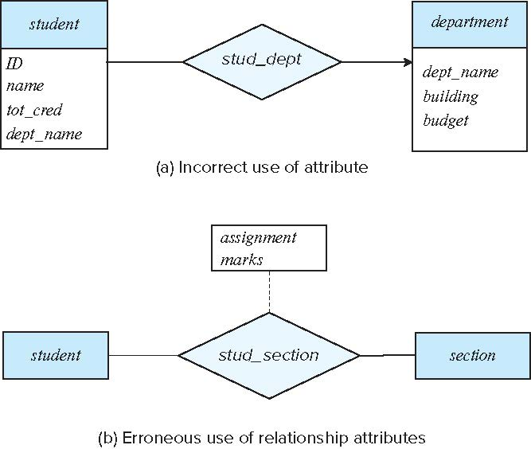
Common Mistakes in E-R Diagrams
Example of erroneous E-R diagrams
Notes:
63

Slide 64
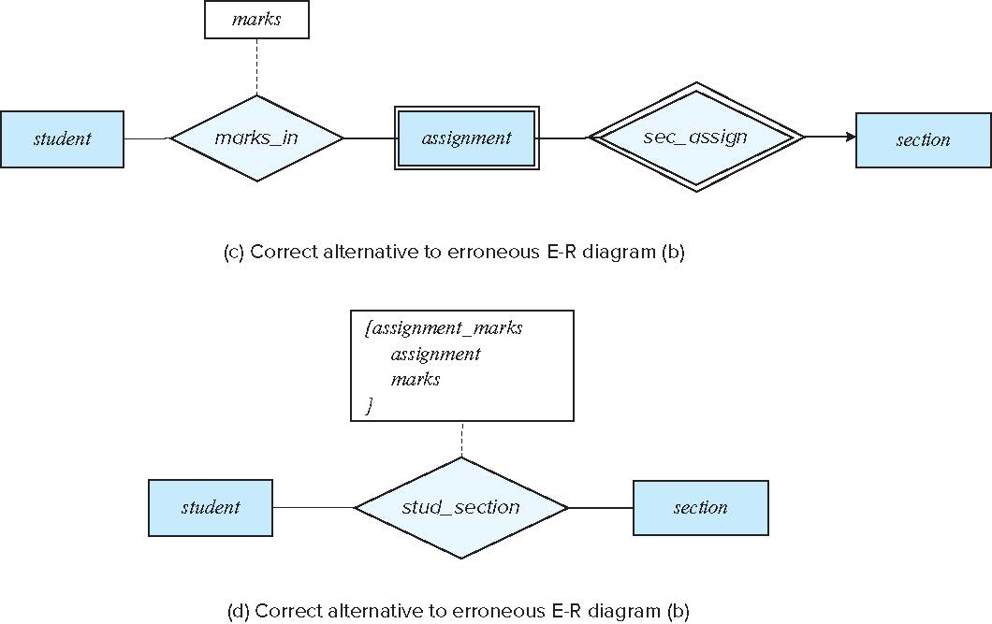
Common Mistakes in E-R Diagrams (Cont.)
Correct versions of the E-R diagram of previous slide
Notes:
64

Slide 65
Entities vs. Attributes
Use of entity sets vs. attributes
Use of phone as an entity allows extra information about phone numbers (plus multiple phone numbers)
Notes:
65

Slide 66
Entities vs. Relationship sets
Use of entity sets vs. relationship sets
Possible guideline is to designate a relationship set to describe
an action that occurs between entities
Placement of relationship attributes
For example, attribute date as attribute of advisor or as attribute of student
Notes:
66

Slide 67
Binary Vs. Non-Binary Relationships
Although it is possible to replace any non-binary (n-ary, for n > 2) relationship set by a number of distinct binary relationship sets, a n-ary relationship set shows more clearly that several entities participate in a single relationship.
Some relationships that appear to be non-binary may be better represented using binary relationships
For example, a ternary relationship parents, relating a child to his/her father and mother, is best replaced by two binary relationships, father and mother
Using two binary relationships allows partial information (e.g., only mother being known)
But there are some relationships that are naturally non-binary
Example: proj_guide
Notes:
67

Slide 68
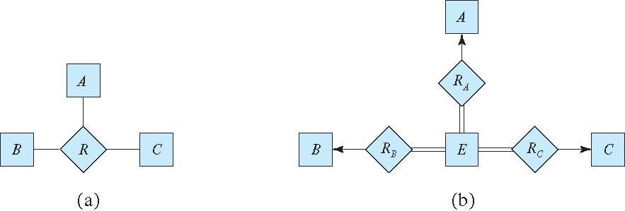
Converting Non-Binary Relationships to Binary Form
In general, any non-binary relationship can be represented using binary relationships by creating an artificial entity set.
Replace R between entity sets A, B and C by an entity set E, and three relationship sets:
1. R_{A}, relating E and A 2. R_{B}, relating E and B 3. R_{C}, relating E and C
Create an identifying attribute for E and add any attributes of R to E
For each relationship (a_{i} , b_{i} , c_{i}) in R, create
1. a new entity e_{i} in the entity set E 2. add (e_{i} , a_{i} ) to R_{A}
3. add (e_{i} , b_{i} ) to R_{B} 4. add (e_{i} , c_{i} ) to R_{C}
Notes:
68

Slide 69
Converting Non-Binary Relationships (Cont.)
Also need to translate constraints
Translating all constraints may not be possible
There may be instances in the translated schema that cannot correspond to any instance of R
Exercise: add constraints to the relationships R_{A}, R_{B} and R_{C} to ensure that a newly created entity corresponds to exactly one entity in each of entity sets A, B and C
We can avoid creating an identifying attribute by making E a weak entity set (described shortly) identified by the three relationship sets
Notes:
69

Slide 70
E-R Design Decisions
The use of an attribute or entity set to represent an object.
Whether a real-world concept is best expressed by an entity set or a relationship set.
The use of a ternary relationship versus a pair of binary relationships.
The use of a strong or weak entity set.
The use of specialization/generalization – contributes to modularity in the design.
The use of aggregation – can treat the aggregate entity set as a single unit without concern for the details of its internal structure.

Slide 71
Advanced SQL
Relational Model
71 | W4111_02_S20: Introduction to Databases – Lecture 5

Slide 72
JOINs
Relational Model
72 | W4111_02_S20: Introduction to Databases – Lecture 5

Slide 73
How to Think About Joins
Remember
The rows in the result are of the form: {ai, aj, am, b1,b7,b11}
Represent a pair of rows that “matched” on JOIN condition.
The way to think about these set diagrams is:
The cartesian product is all possible pairs of rows.
The JOINs represent the subsets of the cartesian product.
73 | W4111_02_S20: Introduction to Databases -- Lecture 6

Slide 74

Useful for Detecting Treason
74 | W4111_02_S20: Introduction to Databases -- Lecture 6

Slide 75

Useful for Detecting Treason
75 | W4111_02_S20: Introduction to Databases -- Lecture 6

Slide 76
How to Think About Joins
Remember
The rows in the result are of the form: {ai, aj, am, b1,b7,b11}
Represent a pair of rows that “matched” on JOIN condition.
The way to think about these set diagrams is:
The cartesian product is all possible pairs of rows.
The JOINs represent the subsets of the cartesian product.
76 | W4111_02_S20: Introduction to Databases -- Lecture 6

Slide 77
Authorization
Relational Model
77 | W4111_02_S20: Introduction to Databases – Lecture 5

Slide 78
Authorization
We may assign a user several forms of authorizations on parts of the database.
Read - allows reading, but not modification of data.
Insert - allows insertion of new data, but not modification of existing data.
Update - allows modification, but not deletion of data.
Delete - allows deletion of data.
Each of these types of authorizations is called a privilege. We may authorize the user all, none, or a combination of these types of privileges on specified parts of a database, such as a relation or a view.

Slide 79
Authorization (Cont.)
Forms of authorization to modify the database schema
Index - allows creation and deletion of indices.
Resources - allows creation of new relations.
Alteration - allows addition or deletion of attributes in a relation.
Drop - allows deletion of relations.

Slide 80
Authorization Specification in SQL
The grant statement is used to confer authorization
grant <privilege list> on <relation or view > to <user list>
<user list> is:
a user-id
public, which allows all valid users the privilege granted
A role (more on this later)
Example:
grant select on department to Amit, Satoshi
Granting a privilege on a view does not imply granting any privileges on the underlying relations.
The grantor of the privilege must already hold the privilege on the specified item (or be the database administrator).

Slide 81
Privileges in SQL
select: allows read access to relation, or the ability to query using the view
Example: grant users U₁, U₂, and U₃ select authorization on the instructor relation:
grant select on instructor to U₁, U₂, U₃
insert: the ability to insert tuples
update: the ability to update using the SQL update statement
delete: the ability to delete tuples.
all privileges: used as a short form for all the allowable privileges

Slide 82
Revoking Authorization in SQL
The revoke statement is used to revoke authorization.
revoke <privilege list> on <relation or view> from <user list>
Example:
revoke select on student from U₁, U₂, U₃
<privilege-list> may be all to revoke all privileges the revokee may hold.
If <revokee-list> includes public, all users lose the privilege except those granted it explicitly.
If the same privilege was granted twice to the same user by different grantees, the user may retain the privilege after the revocation.
All privileges that depend on the privilege being revoked are also revoked.

Slide 83
Roles
A role is a way to distinguish among various users as far as what these users can access/update in the database.
To create a role we use:
create a role <name>
Example:
create role instructor
Once a role is created we can assign “users” to the role using:
grant <role> to <users>

Slide 84
Roles Example
create role instructor;
grant instructor to Amit;
Privileges can be granted to roles:
grant select on takes to instructor;
Roles can be granted to users, as well as to other roles
create role teaching_assistant
grant teaching_assistant to instructor;
Instructor inherits all privileges of teaching_assistant
Chain of roles
create role dean;
grant instructor to dean;
grant dean to Satoshi;

Slide 85
Authorization on Views
create view geo_instructor as (select * from instructor where dept_name = 'Geology');
grant select on geo_instructor to geo_staff
Suppose that a geo_staff member issues
select * from geo_instructor;
What if
geo_staff does not have permissions on instructor?
Creator of view did not have some permissions on instructor?

Slide 86
Other Authorization Features
references privilege to create foreign key
grant reference (dept_name) on department to Mariano;
Why is this required?
transfer of privileges
grant select on department to Amit with grant option;
revoke select on department from Amit, Satoshi cascade;
revoke select on department from Amit, Satoshi restrict;
And more!

Slide 87
Pluggable Authentication Module
87 | W4111_02_S20: Introduction to Databases -- Lecture 6

Slide 88
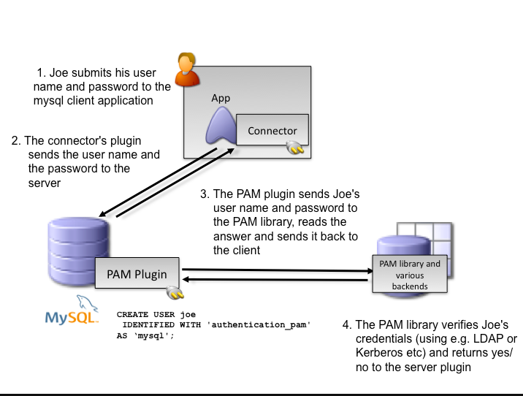
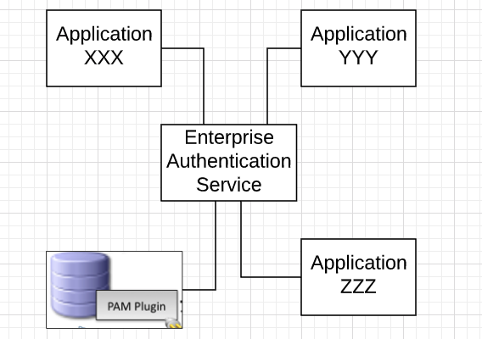
Authentication
Commercial Database Management Systems support
“pluggable authentication modules.”
Simplified Enterprise Authentication Concept
88 | W4111_02_S20: Introduction to Databases – Lecture 6

Slide 89
Authentication
Commercial Database Management Systems support
“pluggable authentication modules.”
89 | W4111_02_S20: Introduction to Databases -- Lecture 3,4

Slide 90
Recursive Queries
Relational Model
90 | W4111_02_S20: Introduction to Databases – Lecture 5

Slide 91
Recursion in SQL
SQL:1999 permits recursive view definition
Example: find which courses are a prerequisite, whether directly or indirectly, for a specific course with recursive rec_prereq(course_id, prereq_id) as ( select course_id, prereq_id from prereq union select rec_prereq.course_id, prereq.prereq_id, from rec_rereq, prereq where rec_prereq.prereq_id = prereq.course_id ) select ∗ from rec_prereq;
This example view, rec_prereq, is called the transitive closure of the prereq relation

Slide 92
The Power of Recursion
Recursive views make it possible to write queries, such as transitive closure queries, that cannot be written without recursion or iteration.
Intuition: Without recursion, a non-recursive non-iterative program can perform only a fixed number of joins of prereq with itself
This can give only a fixed number of levels of managers
Given a fixed non-recursive query, we can construct a database with a greater number of levels of prerequisites on which the query will not work
Alternative: write a procedure to iterate as many times as required
See procedure findAllPrereqs in book

Slide 93
The Power of Recursion
Computing transitive closure using iteration, adding successive tuples to rec_prereq
The next slide shows a prereq relation
Each step of the iterative process constructs an extended version of rec_prereq from its recursive definition.
The final result is called the fixed point of the recursive view definition.
Recursive views are required to be monotonic. That is, if we add tuples to prereq the view rec_prereq contains all of the tuples it contained before, plus possibly more

Slide 94
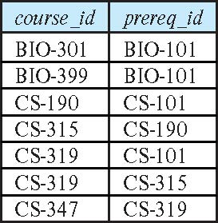
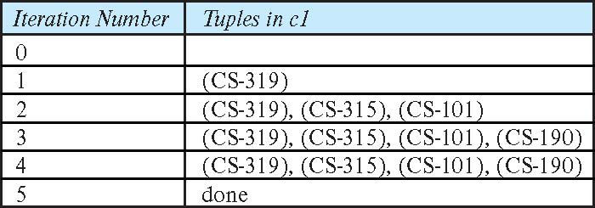
Example of Fixed-Point Computation

